Slide 1
ModEDI
Elizabeth Brooks
Dept. of Computer Science
Western Washington University
Hunter Read
Dept. of Computer Science
Western Washington University
Kalvin Suting
Dept. of Computer Science
Western Washington University
Christopher Stovall
Dept. of Computer Science
Western Washington University
Notes:
Hello I am Elizabeth Brooks…. Today we are presenting ModEDI….. This software architecture may be used to test evolutionary-developmental and quantitative genetic hypotheses.

Slide 2
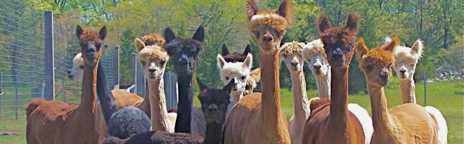
Background - Quantitative Genetics
http://www.bio.miami.edu/dana/250/250SS15_2print.html
Notes:
Quantitative genetics is the study of complex biological traits, or traits controlled by more than one gene. A primary goal of quantitative genetics studies is the development of computational models for predicting the evolution of such traits in response to selection.

Slide 3
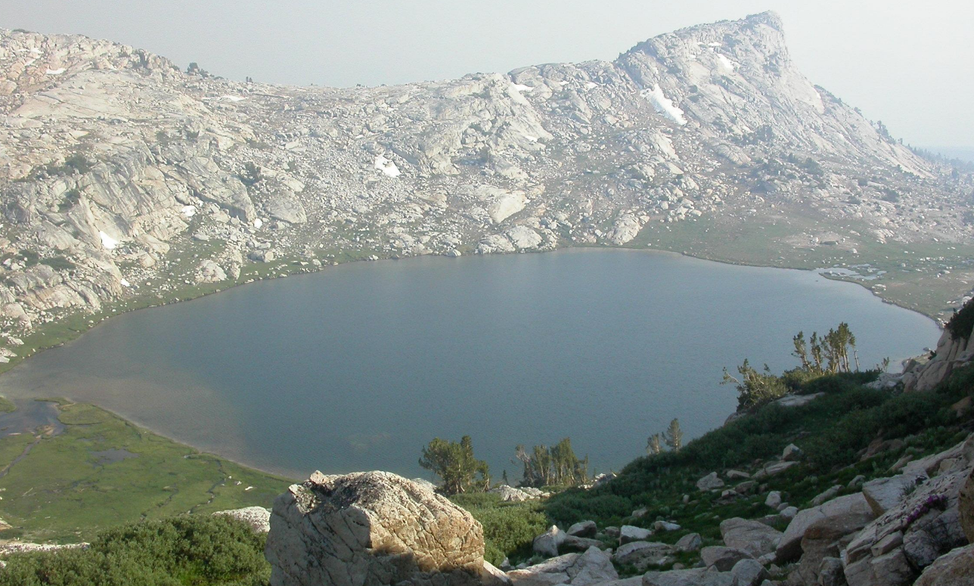
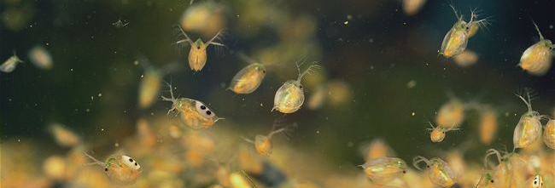
Case Study - Models for Daphnia
http://andynewman.org/html/daphnia_water_flea.html
http://www.archive.org
Notes:
To investigate these complex genetic dynamics, we have developed models of quantitative trait evolution for Daphnia melanica. Daphnia are a freshwater microcrustacean, commonly found in high alpine lakes of the Sierra Nevada.

Slide 4
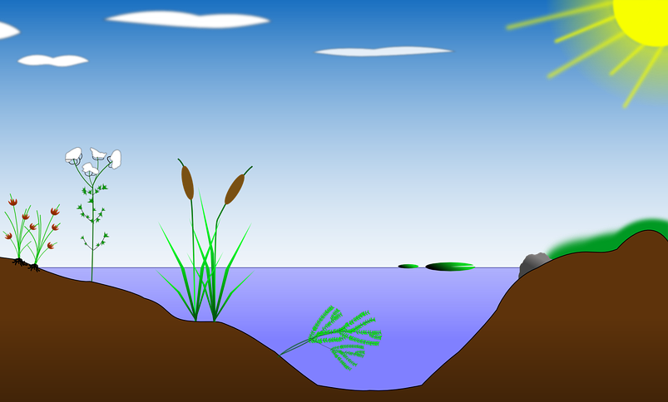
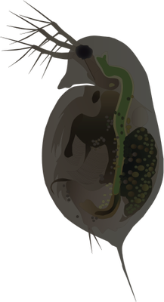


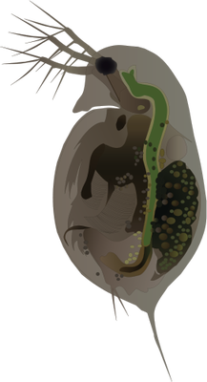

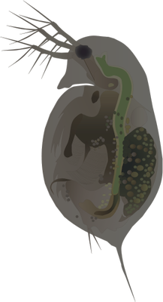

Nonlinear Developmental Interactions (NDI)
http://ian.umces.edu/imagelibrary/displayimage-4387.html
https://pixabay.com/en/biotope-lake-pond-habitat-reed-154853/
Notes:
In these lakes, Daphnia will swim near the water’s surface, receiving a high amount of UV radiation and be dark in pigmentation.

Slide 5
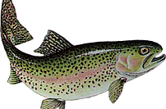
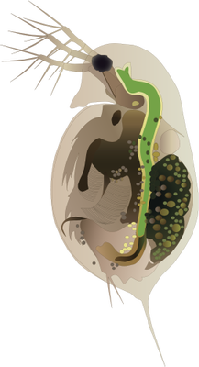
Nonlinear Developmental Interactions (NDI)
http://www.smoka.co.uk/trout
Notes:
When fish predators are introduced into one of these lakes, usually for sport fishing, the Daphnia will migrate lower in the water column to avoid them. By being lower in the water column, the Daphnia receive less UV radiation and are lighter in pigmentation.

Slide 6
Central Concept - Fitness Surface
https://commons.wikimedia.org/wiki/File:Visualization_of_a_population_evolving_in_a_static_fitness_landscape.gif
Notes:
Melanin and dvm along axis
Each point is a daphnia object, clusters populations
Generate individual dvm, melanin ---> generate fitness
Peaks correspond to high fitness, qualitative measure of success

Slide 7
Motivations for parallelization:
Fitness is an important function in evolutionary models
Scalability for increased model complexity
Parameter sweeps to efficiently test hypothesis
Sequential execution time
Notes:
Model complexity : number of traits per model
Sequential execution of parameter sweeps and multiple models slow

Slide 8
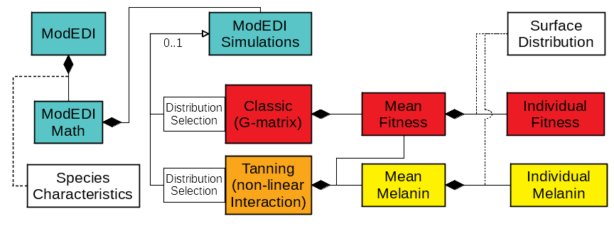
Software Architecture
Notes:
The Tanning model, however, projects the evolution of physical traits by drawing from the phenotype surface calculated by the Mean Melanin class. The phenotype surface is described by the function for melanin production in the Individual Melanin class, with the user specified distribution described by the Surface Distribution interface.

Slide 9
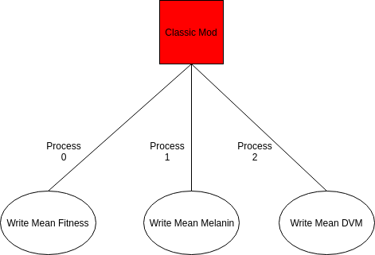
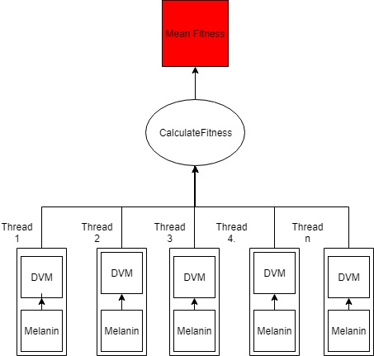
Critical Section: Using OpenMP
I/O: Using MPI
ModEDI Task Dependency Graphs
Notes:
Mean Fitness: build melanin, dvm distribution objects sequentially and use them to find find meanfitness. Note: only one fitness object per thread shown, each thread would have multiple calculations
Each thread has multiple calculations with that fitness object
Used MPI to parallelize the I/O with 3 processes
One process wrote the mean fitness, one did mean melanin, and the last did mean DVM. Little impact

Slide 10
ModEDI Parallelization Workflow
Translate Java code base to C++
Parallelize critical section using OpenMP
Parallelize I/O using MPI
Optimize critical section
Compare run times by task size
Determine communication costs
Notes:
Java -> C++
Determine ways to parallelize the project
-Parallelize critical section using OpenMP
-Parallelize the I/O with MPI
+Ongoing task
-Find the best method for parallelizing the critical section which included
Investigating how task size impacted run time
Finding the communication cost and the optimal task size to offset it
-As it turns out, the critical section had the bulk of computation done, which is why we put emphasis on optimizing it

Slide 11
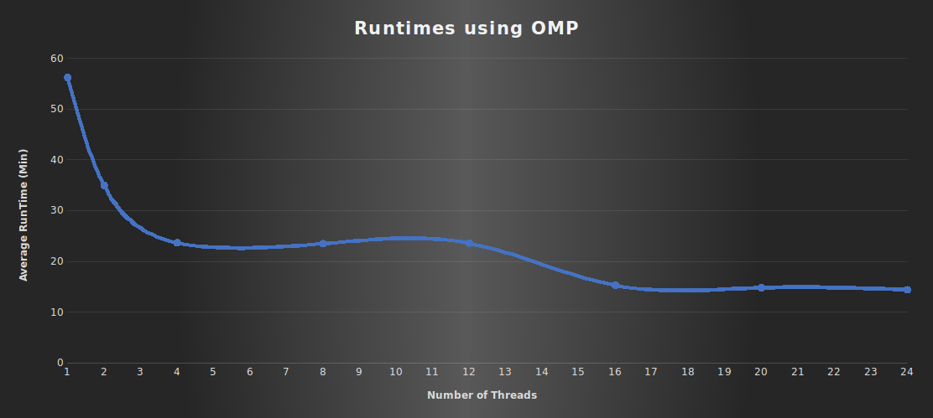
Parallel - Results
Notes:
Values for UVB dose at the water surface and attenuation coefficient were obtained from Sequoia National Park in the Sierra Nevada Range. Values specific to Daphnia were obtained from empirical studies. Starting trait values match mean values from populations that have not been subject to fish predation. Fitness optima were estimated from mean trait values in populations that have been subject to selection by human-introduced fish predators for approximately 100 years. Variances of the fitness surface and heritability were chosen to represent plausible values.
-These results are the minimum of the averages computed for each number of threads for the different methods in parallelizing the critical section.
-The plateau in the graph was likely caused by load imbalance, where chunking up the critical section further result in unequal work distributions.
-Given that the size of the computation done became very small, such chunking was not very beneficial, even without the load imbalance

Slide 12
Conclusions - Future Work
Parallelized for scalability
Granularity of evolutionary hypothesis
Type of species
Number of physical traits
Calculating mean fitness is nearly 70% of program computations
Communicate in bulk to amortize startup costs
Reduce volume of communication
Reduce task size
Load imbalance
Further improve I/O time with MPI

Slide 13
Questions?

